Slide 1
Clean Code
“Any fool can write code that a computer can understand.
Good programmers write code that humans can understand.”
— Martin Fowler
Prepared by: Ali Khalaf

Slide 2
What is Clean Code?
Myth: “If it works, it’s clean.” → False.
Truth:
Readable, maintainable, and self-explanatory.
Written for people, not just machines.
Why Care?
Developers spend 80% of time reading code
Critical for team collaboration, debugging, and future updates.
You are not only a programmer you are an AUTHOR!!

Slide 3
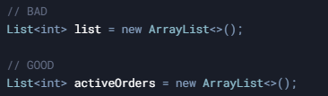
Naming Principles
Meaningful Names:
Replace “u” with “user”, “v” with “isValid”.
Avoid "noise words" like “data”, “info” (e.g., userData → user).
Consistency:
Use the same term across the codebase (e.g., fetch vs. retrieve).
Avoid Redundancy:
Class names should not repeat the context (e.g., Car.carSpeed → Car.speed).

Slide 4
Naming Anti-Patterns & Best Practices
Anti-Patterns
Best Practices
Cryptic Abbreviations: ordSts → orderStatus
Pronounceable Names: genymdhms → generationTimestamp
Misleading Names: accountsList (if not List) → accounts
Searchable Names: MAX_ORDERS_PER_DAY instead of 100
Magic Numbers: if (status == 2) → ORDER_COMPLETED
Naming is technical communication. A good name answers:
Why it exists?
What it does?
How it’s used?

Slide 5
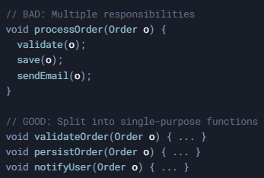
Functions
Do One Thing: Single responsibility.
Small: ≤ 20 lines.
DRY: Eliminate duplication.

Slide 6
Comments
Comments to Avoid:
Redundant: // increment count → count++;
Outdated: // TODO: Fix in 2020 (still there in 2025).
Good Comments:
Legal: // Copyright 2023, Company X.
Warnings: // WARNING: Costs $0.01 per call.
Complex Logic: // Uses SHA-256 for secure hashing.

Slide 7
Formatting
Vertical Formatting:
Group related code (e.g., variable declarations near usage).
Separate concepts with blank lines.
Functions should be short enough to fit on one screen (~20 lines).
Horizontal Formatting:
Limit line length to 80–120 characters (improves readability).
Use indentation consistently (e.g., 2/4 spaces).
Team Consistency:
Agree on formatting rules (tabs vs. spaces, brace placement).
Use IDE auto-formatters (e.g., Prettier, IntelliJ).

Slide 8
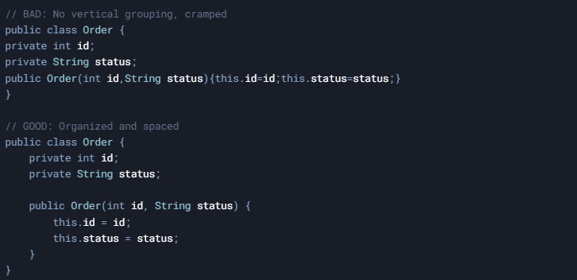
Formatting

Slide 9

The Boy Scout Rule
How to Apply:
Fix small issues:
Rename a confusing variable.
Break up a long function.
Delete a redundant comment.
Impact:
Prevents "broken windows" (minor issues → chaos).
Gradual improvement without massive rewrites.
"Leave the code cleaner than you found it."

Slide 10
Naming Case Types
Case Type | Example | Used In | Typical Usage
snake_case | is_valid | Python | Variables, Functions, Methods
camelCase | isValid | Java, JavaScript | Variables, Functions, Methods
PascalCase | AdminRole | Python, Java, JS | Classes, Types
kebab-case | <side-drawer> | HTML | Custom HTML/Web Components

Slide 11
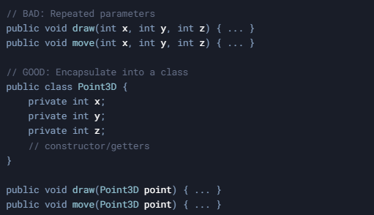
Code Smells & Refactoring
Common Smells:
Long Methods:
Functions > 20 lines → Break into smaller methods.
Primitive Obsession:
Overusing primitives (e.g., String phone) → Replace with objects (PhoneNumber class).
Data Clumps:
Groups of variables passed together (e.g., x, y, z) → Encapsulate into a class (Point3D).

Slide 12
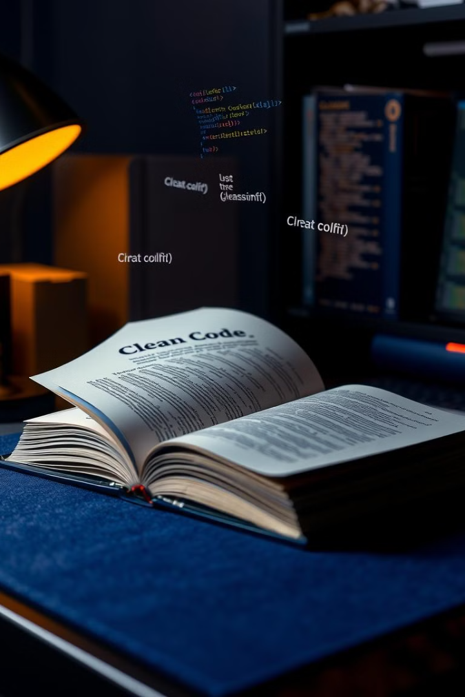
Key Principles of Clean Code
1
Agile Craftsmanship
Clean code enables agility
2
Relentless Refactoring
Continuous improvement
3
Readability
Prioritize clarity over complexity
4
Future-Proof
Maintainable, understandable code
Reference: Clean Code by Robert C. Martin

